Slide 1
Happy Monday
Check-in

Slide 2

iClicker Question
Higher levels of measurement have all the properties of lower levels of measurement
True
False
Notes:
True

Slide 3
iClicker Question
You can calculate the average of ratio scale using mean
TRUE
FALSE
Notes:
You need geometric mean or harmonic mean

Slide 4
iClicker Question
Ordinal and nominal scales are categorical, while interval and ratio are continuous
TRUE
FALSE

Slide 5
iClicker Question
There is a true 0 in ratio scale, while interval scale has only an arbitrary 0
TRUE
FALSE
Notes:
True

Slide 6
iClicker Question
What type of scale is this?
How many ounces of Coke do you consume per day?
Nominal
Ordinal
Interval
Ratio
Notes:
Ratio (true 0)

Slide 7
iClicker Question
What type of scale is this?
Rate your attitude toward Coke from extremely unfavorable to extremely favorable.
Nominal
Ordinal
Interval
Ratio
Notes:
Interval (no true 0)

Slide 8
iClicker Question
What are the errors associated with the observed responses we learned in class?
Systematic and Random Error
Type I and type II Error
Measurement Errors and Gross Errors
Notes:
Gross Error: This category basically takes into account human oversight and other mistakes while reading, recording, and readings. The most common errors, the human error in the measurement fall under this category of errors in measurement

Slide 9
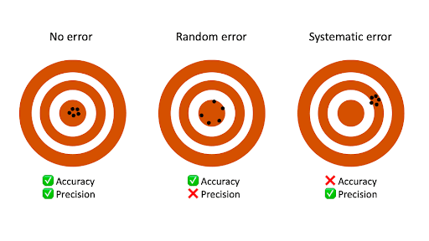
iClicker Question
Which bullseye shows reliability but not validility?
A
B
C
A
B
C
Notes:
C

Slide 10
Recap Last Class
Measurement
Scales
Reliability
Validity

Slide 11




Designing the Data Collection Form for Communication Data
Notes:
Chapter 13

Slide 12
Learning Objectives
Define recall loss and explain how they affect a respondent’s ability to answer questions accurately
List some techniques that researchers use to secure respondents’ cooperation in answering sensitive questions
List some of the primary rules researchers should keep in mind in trying to develop bias-free questions
Explain what the funnel approach to question sequencing is
Explain what a branching question is and discuss when it is used
Explain the difference between target information and classification information and tell which should be asked first in a questionnaire
Explain the role of pretesting in the questionnaire development process

Slide 13
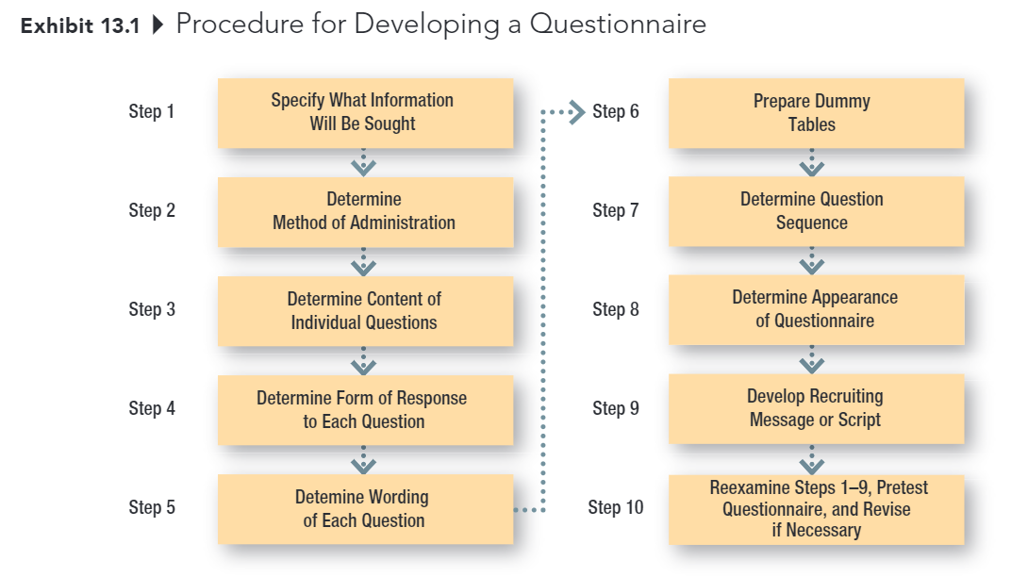
Developing the Data Collection Form
Notes:
This is the procedure for developing a questionnaire. We will go over each step in detail

Slide 14
Step 1: Specify what info is needed
The first step should be relatively easy, assuming that the researchers have done a good job at earlier stages in the research process
Hypotheses, dummy tables, etc., make it clear what information is needed
Notes:
The first step is to determine what information is needed
This is relatively easy, if we already define clearly our managerial objectives, research objectives, and research question.
To test our hypothesis, which usually mean how A is related to B, we have to collect data, right?
For example, you want to make sure your hypothesis that there is a difference between athlete students and non-athlete students in regard to attitude towards the rec center?
Then, you will have to ask your respondents two questions:
The first one is classification question (whether he or she is an athlete)
The second question is his or her attitude towards the rec center.
So for only one research question, you might have to post two questionnaire questions in order to answer it.

Slide 15
Step 2: Determine Method of Administration
The degree of structure and disguise influence this decision, as does the specific research situation
Personal Interview
Telephone Interview
Mail Survey
Online Survey
Notes:
As mentioned in the last class, as a researcher , you have flexibility to choose the method of administration, which are
Personal interview
Telephone Interview
Mail Survey
Online Survey
But for this class, you will mostly do online survey.
You can also do in-person survey, in which case you can print out your survey (or use ipad or tablets) and ask students to fill it out in-person
However, I’d like to limit your contact because of Covid. Hence, I’d strongly recommend you to send your Qualtrics link to respondents in order to collect data.
I think I can reasonably assume that y’all know how to do this already because you had to send out your Qualtrics survey to collect data to turn them in for the last assignment.
Then, this method of administration shouldn’t be a problem for you.

Slide 16
Step 3: Determine Content of Individual Questions
Some key issues:
Is the question necessary?
Are several questions needed instead of one?
Do respondents have the necessary information?
Will respondents give the information?
Filter Question:
Do you do the grocery shopping for your family?
Have you eaten at Mickey’s restaurant, located …, within the past 6 months?
Did you vote in the last presidential election?
Notes:
Before we determine the mode of responses that we want our respondents to answer, we have to consider content in each question first
Some key issues to consider are
1. We only pose question that is absolutely necessary because customers have only limited cognitive ability to answer, then you would want to use it wisely.
However, there is a caveat that sometimes, we do need necessary redundancy. Can someone guess why sometimes we need to prolong our survey?
For example, you are asking successive questions that might let the respondents know or guess your true research purpose, in which case you will have desirability bias (they are more likely to answer to what you want or expect). Then, in this case, we might introduce misleading questions to obscure respondents’ knowledge of the research purpose.
Secondly, related to the first issue, we would want the most parsimonious questionnaire, which means one with the least amount of questions
Thirdly, we also have to ask the question whether your respondents have the necessary information? To clarify this issue, we need to keep in mind who our informants are (whether it is customers, or salesperson, or stakeholders).
Regarding the third issue, we can pose filter questions to determine if a respondent is likely to possess the knowledge being sought; also used to determine if an individual qualifies as a member of the defined population
Examples can be: read questions
And in our project, we have two objectives: raise awareness of new customers or increase satisfaction of existing ones. Then, you also need to filter those who are not in your sample (for example: )
Lastly, whether the respondents will give you the information that you seek. We will go into this problem
Filter: A question used to determine if a respondent is likely to possess the knowledge being sought; also used to determine if an individual qualifies as a member of the defined population
Recall loss: A type of error caused by a respondent’s forgetting that an event happened at all

Slide 17
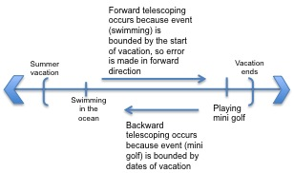
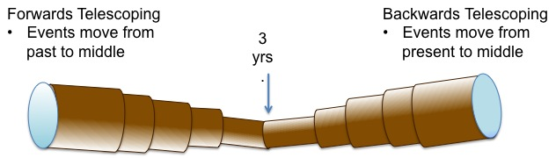
Step 3: Continued (Telescoping error)
Telescoping error: A type of error resulting from the fact that most people remember an event as having occurred more recently than it did
Notes:
Telescoping error (also known as telescoping bias): A type of error resulting from the fact that most people remember an event as having occurred more recently than it did
For example, you want to determine how much Coke had been purchased among a sample of consumers over the prior week. The estimates provided by the respondents will almost always be too high as they recall purchases made prior to the focal second-day period.
Interestingly, as the time periods respondents are asked to consider get shorter, the telescoping error gets worse
Three years is approximately the time frame in which events switch from being displaced backward in time to forward in time, with events occurring three years in the past being equally likely to be reported with forward telescoping bias as with backward telescoping bias

Slide 18

Step 3: continued (Recall loss)
A type of error caused by a respondent’s forgetting that an event happened at all
Notes:
Recall loss: A type of error caused by a respondent’s forgetting that an event happened at all
As time passes, people forget things. Hence, the longer the time period you are asking, the more likely the respondents encounter recall loss.
Since recall loss and telescoping error work in opposite direction, there in principle will be an optimal time frame to ask a particular question. (which is usually two weeks, to one month).

Slide 19
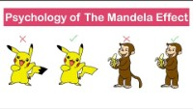
The Mandela Effect
Notes:
Besides the fact that sometimes we can’t recall things, or recall them more recently than they were. A more disturbing error is the Mandela effect
The Mandela effect occurs when a person believes that their distorted memories are, in fact, accurate recollections. They can clearly remember events that happened differently or events that never occurred at all. The bottom line is that the Mandela effect does not involve lying or deception.
2:08 only, then go on

Slide 20
Handling Sensitive Questions
Don’t ask unless absolutely necessary!
Guarantee anonymity
Place sensitive questions near end
Include a counter biasing statement
Ask about how others might feel
Ask for general, rather than specific, information (e.g., categories for answers)
Use randomized response model
Notes:
Even in the case that respondents remember the information that we want, they might not be willing to tell us.
So now we have to think how we should handle sensitive questions.
Again, don’t ask unless it’s absolutely necessary
Then, another option you can choose to do is to guarantee anonymity to your respondents, to make them feel more comfortable. People behave more natural under situations that have high social expectation or social rules if they are anonymous.
Moreover, we usually place sensitive questions near the end to avoid large attrition rate. If you place your questions early on, it’s very likely that your respondents will abandon the survey.
However, after answering a lot of questions, your respondents have vested interests, and already incur sunk cost, now when you introduce the sensitive question, it’s less likely that your respondents will abandon the survey now. Because the thought process would be that I’ve answer this far already, I better finish it (sunk cost fallacy).
Another solution is to include a counter biasing statement that indicates that the behavior or attitude in question is not unusual. For example, “Due to recent financial recession, one out of every four households has trouble meeting its monthly financial obligations”, then you can proceed to ask questions about household financial difficulties.
OR instead of asking about how your respondents feel, you can how they think others might think, which is the projective methods that we already covered.
Another alternative is to ask for general rather than specific information. For example, instead of proving a precise answer regarding customers’ salaries, you can ask them check one of the boxes like making less than 60K, 60K-120K, and more than 120K
Lastly, we can also use randomized response model: An interviewing technique in which potentially embarrassing and relatively innocuous questions are paired, the question the respondent answer is randomly determined but is unknown to the interviewer

Slide 21
Example Response Model
Q1: Have you used cocaine before?
Q2: Flip a book and answer: is the page number odd? Yes or no?
The respondent: flip a coin to decide which question to answer
The interviewer: does not know the outcome of the coin
The randomization device must have:
Known probability t that the person is asked the sensitive question and (1-t) that the person is asked other questions
The probability that the person response yes to the other question is known
Notes:
If we have time, we will comeback to this.
There shouldn’t be any question in the quiz regarding this concept, if you encounter one, let me know.
The two answers must be equivalent such as yes/no
The respondents must understand that the interviewers do not know what question the respondents were asked.

Slide 22
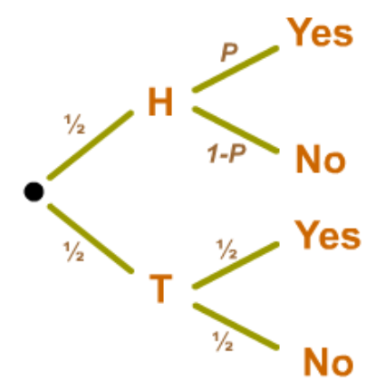
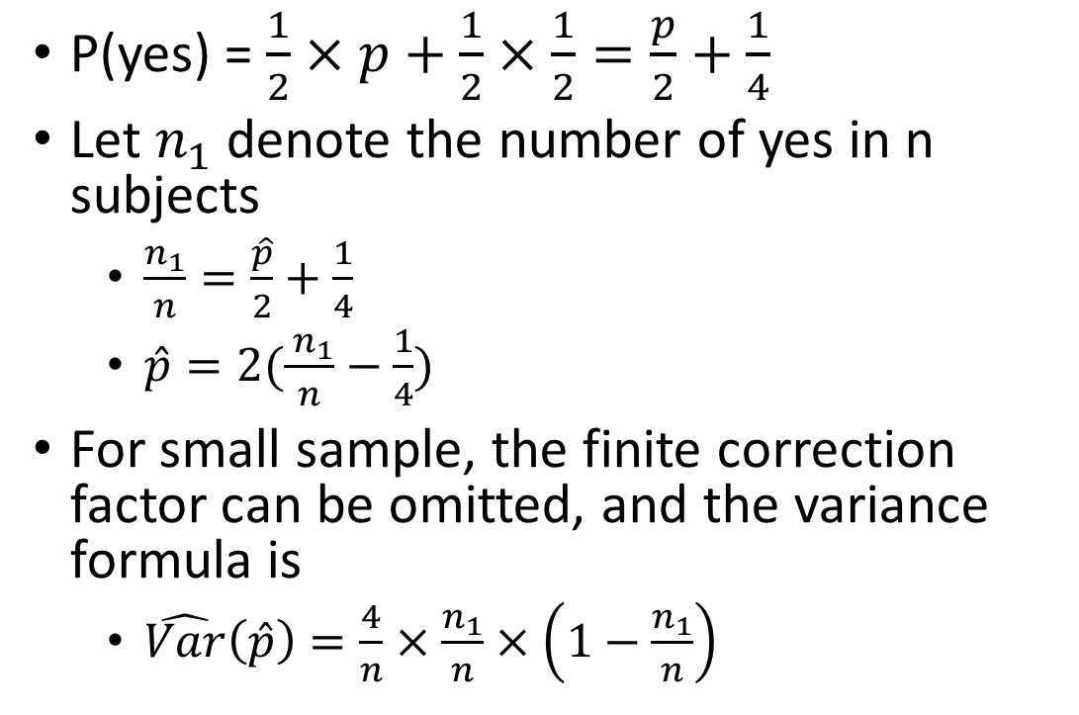
Example Response Model (cont.)
P(yes) = $\frac{1}{2}×p+\frac{1}{2}×\frac{1}{2}=\frac{p}{2}+\frac{1}{4}$
Let $n_{1}$ denote the number of yes in n subjects
$\frac{n_{1}}{n}=\frac{\hat{p}}{2}+\frac{1}{4}$
$\hat{p}=2(\frac{ n_{1}}{n}−\frac{1}{4})$
For small sample, the finite correction factor can be omitted, and the variance formula is
$\hat{Var}\left(\hat{p}\right)=\frac{4}{n}×\frac{n_{1}}{n}×\left(1−\frac{n_{1}}{n}\right)$
Notes:
Example from PSU stat https://online.stat.psu.edu/stat506/lesson/12/12.3

Slide 23
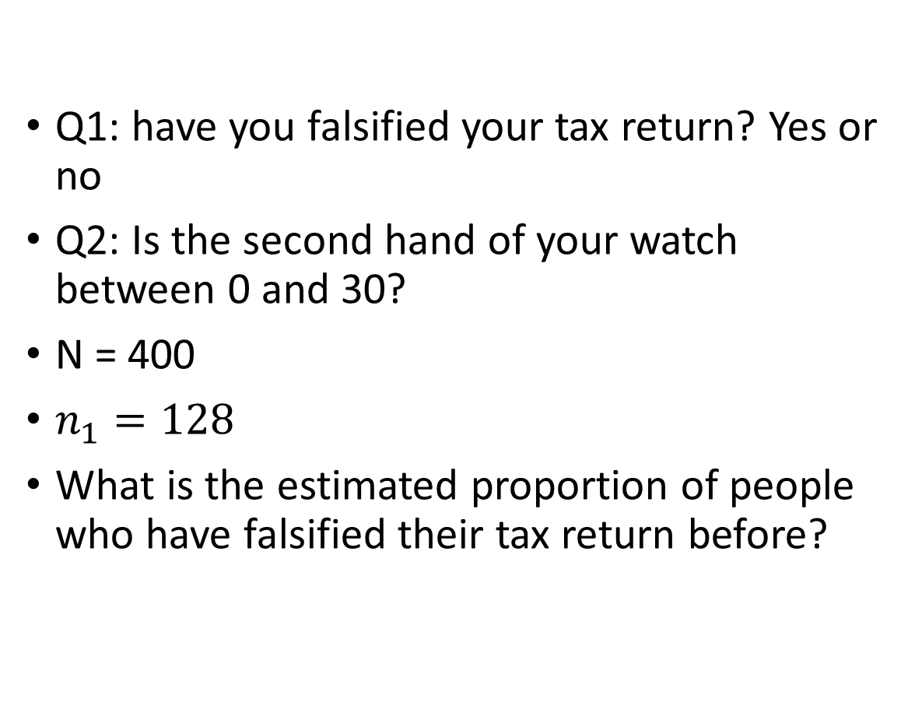
Bonus Question (Extra Credit)
Q1: have you falsified your tax return? Yes or no
Q2: Is the second hand of your watch between 0 and 30?
N = 400
$n_{1}=128$
What is the estimated proportion of people who have falsified their tax return before?
Notes:
P = 2(128/400 – ¼) = 0.14

Slide 24
Counterbiasing Statement
Recent studies show that one of every four households has trouble meeting its monthly financial obligations. Is your household currently experiencing financial difficulties?
Yes
No
Notes:
This is the example of counterbiasing statement that I’ve already mentioned above

Slide 25
Step 4: Determine Form of Response to Each Question
Open-Ended Questions vs. Closed-Ended Questions
Notes:
In step 4, we have to determine the form of repose to each question
Which are open-ended vs. closed-ended

Slide 26
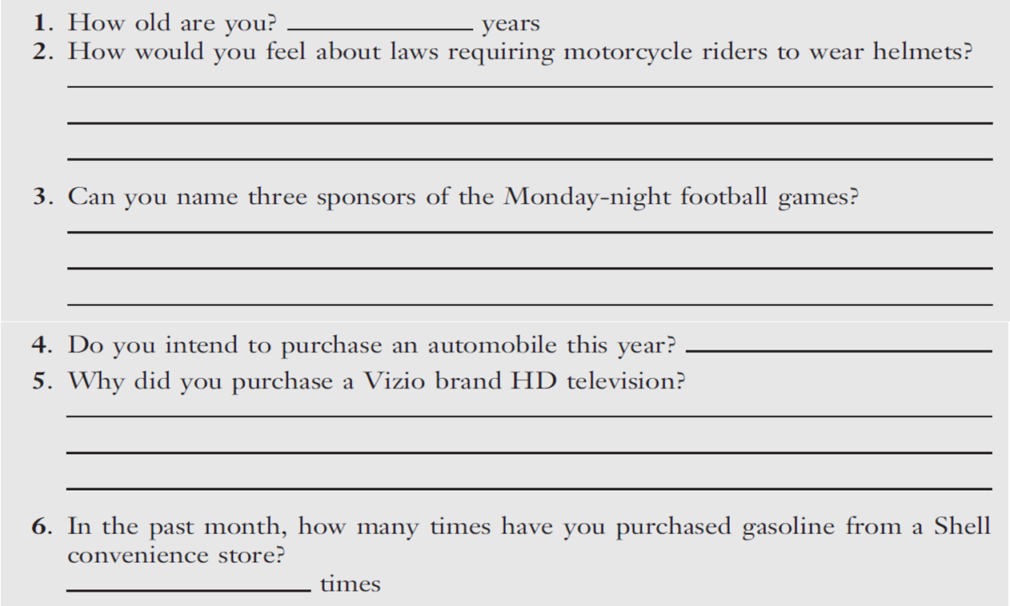
Open-Ended Questions
Notes:
There are examples of open-ended questions
Such as

Slide 27
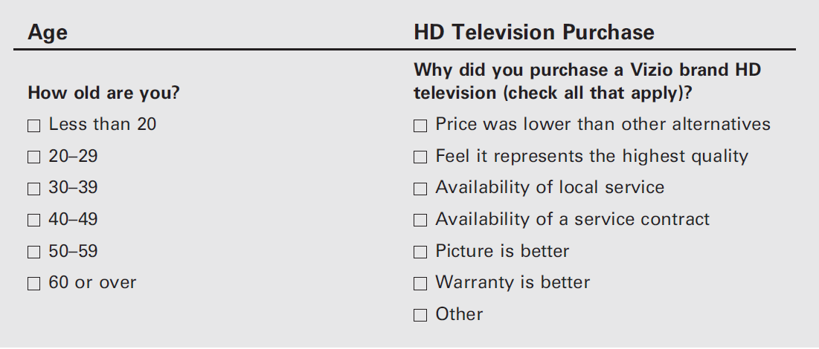
Closed-Ended Questions
Notes:
Then, close-ended questions are
Why do you think we want to use closed-ended questions, or the other way around?
Explore, vs. structure.

Slide 28

Close-Ended Questions
With closed-ended questions, the response categories must be exhaustive; all reasonable responses must be included
In addition, response categories must be mutually-exclusive, except in special cases where more than one answer is acceptable (e.g., check all that apply)
Notes:
There are two conditions you need to fulfill when you pose a close-ended question, which are exhaustive and mutually exclusive.
Regarding being exhaustive, it means all reasonable responses must be included
And in addition …

Slide 29
Response Order Bias
An error that occurs when the response to a question is influenced by the order in which the alternatives are presented
Notes:
There is another concern when creating a survey, which is response order bias.
It is an error …

Slide 30
Split-Ballot Technique
A technique for combatting response bias in which researchers use multiple versions of a survey, with different wordings of an item or different orders of response options
(Version A) Do you think gasoline will be more expensive or less expensive next year than it is now?
◻ More expensive
◻ Less expensive
(Version B) Do you think gasoline will be more expensive or less expensive next year than it is now?
◻ Less expensive
◻ More expensive
Notes:
To combat the response order bias, we can use split-ballot technique, in which …
For example, …
I believe in Qualtrics, there is an option for you to tell Qualtrics to randomize your answers.

Slide 31
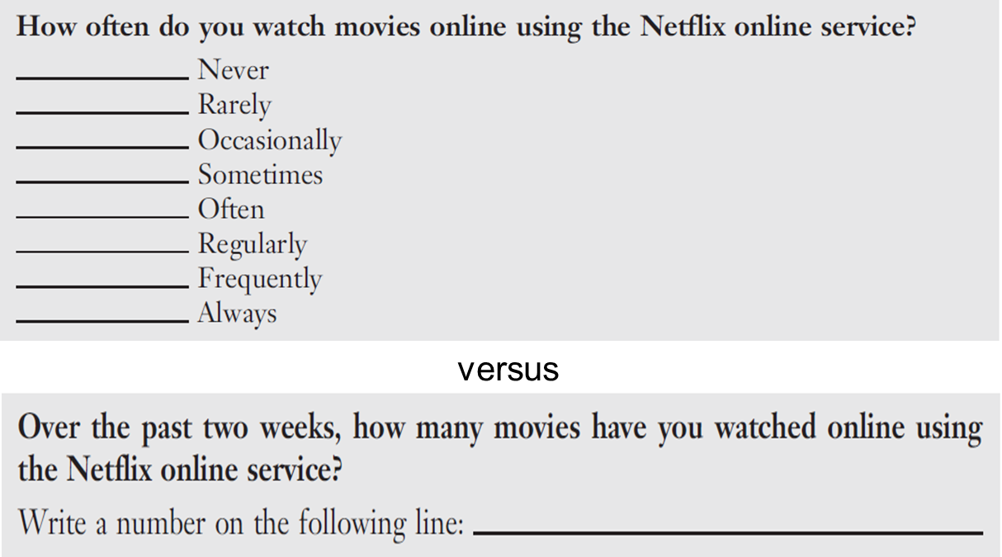
Step 5: Determine Wording of Each Question
Use simple words
Language used should be driven by the ability level of the population; err on the side of simplicity
Avoid Ambiguous Word and Questions
Notes:
In step 5, we determine wording of each question
Rule of thumb is to use simple words (but you should also consider the ability level of your target population (e.g., students, or professionals)
And try to avoid ambiguous words and questions.
For example, …
The first example might be exhaustive, but it’s rather long and complex, while the second one is more straight forward.

Slide 32
Some Problem Words: Be Careful!
All
Always
And
Dinner
Feel
Government
If
Never
Occasionally
Often
Or
Rarely
Regularly
Sometimes
Usually
Where
You
Notes:
And there are some words that we avoid using if we can.
And it’s general rule of thumb when you make a statement, we shouldn’t use always, all, or never, because one can almost always find outliers or black swan events
You can review this slide later when creating your questionnaire

Slide 33
Step 5: Determine Wording of Each Question
Avoid Leading Questions
Notes:
Another concern is that we should avoid leading questions.
For example, …

Slide 34

REMINDER: No Advocacy Research
Reputable media outlets provide
the actual questions
a description of the study
information about the sample
Notes:
So a reminder, we don’t do advocacy research. And we have to carefully examine your source
A reputable media outlet would provide …

Slide 35
Words that Might Signal Leading Questions
Allege, allude, arbitrary, blame, claim, demand, error, failure, fault, ignore, ill-advised, ill-informed, incompetence, ineptness, insist, just, maintain, misinformed, must, neglected, one-sided, only, overreact, peremptory, purport, questionable, rejection, rigid, so-called, unfortunately, unilateral, unreasonable
Notes:
Here are some words that might signal leading questions, again you can refer to this slide when creating your questionnaire
Source: “Guide to Writing Survey Questions,” Management Analysis and Development, downloaded from http://www.mad.state.mn.us/ on October 25, 2012.

Slide 36
Things to be Avoid
Avoid Unstated Alternatives
An alternative answer that is not expressed in a question’s options
Thorough exploratory research and questionnaire pre-testing is the answer!
19% said “no” “Would you like to have a job, if this were possible?”
versus
68% said “no” “Would you prefer to have a job, or do you prefer to do just your housework?”
Notes:
Things to be avoid which include unstated alternatives
We examine two questions: 19% …
As you can see, in the first example, the alternative answer is not exclusive stated, which might be misleading to the respondents
Almost everyone wants to have a job, but what we are looking for is the comparison between job and housework preference

Slide 37
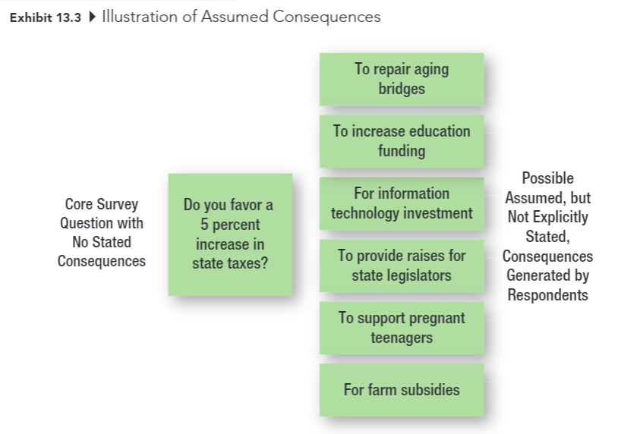
Things to be Avoid
Avoid Assumed Consequences
When a question is not framed to clearly state the consequences and thus generates different responses from individuals who assume different consequences
Notes:
Another flaw that we want to avoid is assumed consequences,
When a question is not framed to clearly state the consequences and thus generates different responses from individuals who assume different consequences.
For example, you want to ask about people’s preference regarding the allocation of increased tax.
Do you favor a 5 percent increase in state taxes?
If you pose this question, no one is going to say yes. But what you actually want to ask is where they want to allocate this tax money.

Slide 38
Things to be Avoid
Would you like to double the number of job offers you receive as a senior?
◻ Yes  ◻ No
Would you like to double the number of job offers you receive as a senior if that means devoting an additional 10 hours per week to studying so as to raise your grade point?
◻ Yes  ◻ No
Notes:
Another example of assumed consequences is that
…

Slide 39

Things to Avoid
Avoid Generalizations and Estimates
Questions should always be asked in specific, rather than general terms
When asking about the frequency of behaviors (e.g., shopping, purchase) use an appropriate item frame that doesn’t force respondents to make estimates

Slide 40
Things to Avoid
Avoid Double-Barreled Questions
Watch out for and and or…
Notes:
Another pitfall is double barreled questions.
For example, …
In this example, when the customers answer, you don’t know which activity they are referring to
Is it the price of the quality of the service.
So you should avoid using and and or in your question

Slide 41
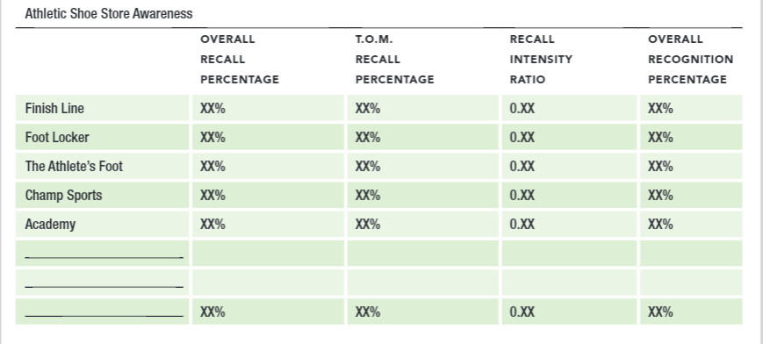
Step 6: Prepare Dummy Tables
Dummy Table: A table (or figure) used to show how the results of an analysis will be presented
Notes:
Then in step 6, you can prepare dummy table.
Before, we usually have to prepare this table to know how the results of an analysis will be presented
But now, with Qualtrics or other survey services, you don’t need to prepare this table

Slide 42
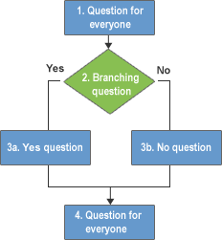
Step 7: Determine Question Sequence
Use simple and interesting opening questions
Use the funnel approach
State with broad questions and progressively narrow the scope
Question Order bias: the tendency for earlier questions on a questionnaire to influence respondents’ answers to later questions
Design branching questions with care
Branching questions direct respondents to different places in a questionnaire, based on their response to the question at hand
Notes:
In step 7, you have to determine the question sequence, which want you want to pose first.
The general rule of thumb is to use …
We cover response order bias, but here we have question order bias which is the tendency …
Hence, you should also be careful with this bias
If you have branching question, you should let Qualtrics knows.
For example, …

Slide 43
Step 7: Determine Question Sequence
Ask for classification information last
Target info: The basic info that addresses the subject of the study
Classification info: Information used to classify respondents, typically for demographic breakdowns
Place difficult or sensitive questions late in the questionnaire
Notes:
Classification info is different from filter question
Filter question is for you to determine whether the respondents have the correct information to continue with the questionnaire
Classification info is more like for segmentation purpose. Your difference research question would require this information.
For example, if you choose existing customers, you can still have classification question between athlete and non-athlete students.

Slide 44
Step 8: Determine Appearance of Questionnaire
No clutter!
Keep is as short as possible
Use care with branching questions
Use graphics as needed to improve appearance
Number question within sections
1-1, 2-1, 3-1, 2-1, 2-2, etc.
Include an organization name (sometimes fictitious) and project title
Go easy on instructions, unless they are absolutely necessary (again, see second bullet point)
Notes:
In step 8, you will have to determine the appearance of the questionnaire,
There are a few rules of thumb:
No clutter,
Keep is as short as possible (as mentioned in the instruction, your survey should fit in a page only)
…

Slide 45
Step 9: Develop Recruiting Message or Script
Good cover letters and scripts are NOT written in a hurry
The usually things to include
Who you are
Why you are contacting them
Promise of anonymity or confidentiality
The request for help
How long it will take
Any incentives
Notes:
Step 9 is to develop recruiting message or script
I know that some groups have already started on cover letters.
I want to emphasize that …
Please check on these items when creating your cover letter

Slide 46
Step 10: Reexamine step 1-9, Pretest
Developing a questionnaire is a VERY difficult process. It normally requires several revisions of the data collection form
Pretest: Use of a questionnaire (or observation form) on a trial basis in a small pilot study to determine how well the questionnaire (or observation form) works
The real test of a questionnaire is how it performs under actual conditions of data collection
Data collection should NEVER begin until you have pretested – and probably revised again –the questionnaire
Notes:
As I mentioned in the last class that you typically use a pilot study to figure out where we can improve before we introduce the survey to the mass population. I hope after this class you can go home and create a version of your questionnaire and in Wednesday’s class, we will swap survey to see how we perform on it.

Slide 47

Observation Forms
Decisions about …
WHO should be observed?
What aspects should be reported?
WHERE should the observation be made?
WHEN should the observation be made?

Slide 48
Next
Read chapter 14
Prepare your questionnaire to swap in the next class
Notes:
For the next class, please read chapter 14. I made a slight changes to the syllabus, that we will cover chapter 14 on Wednesday

Slide 49

15-min Group Discussion
Assignment 4 (Questionnaire)

Slide 50
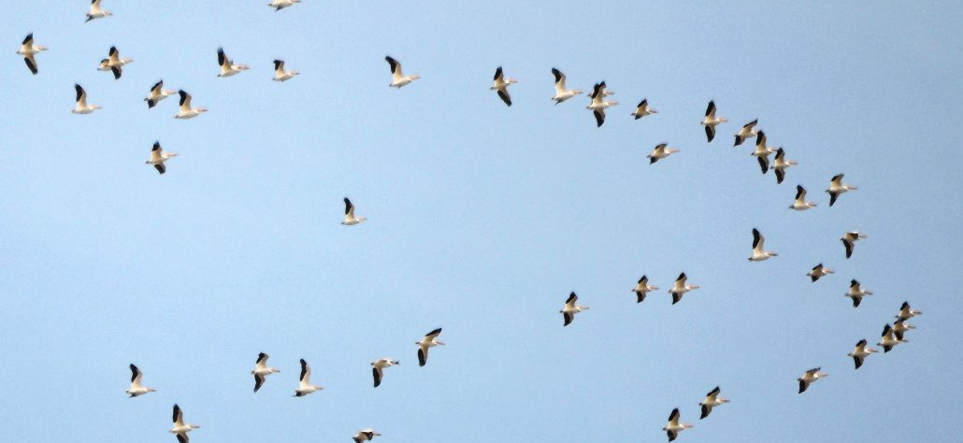
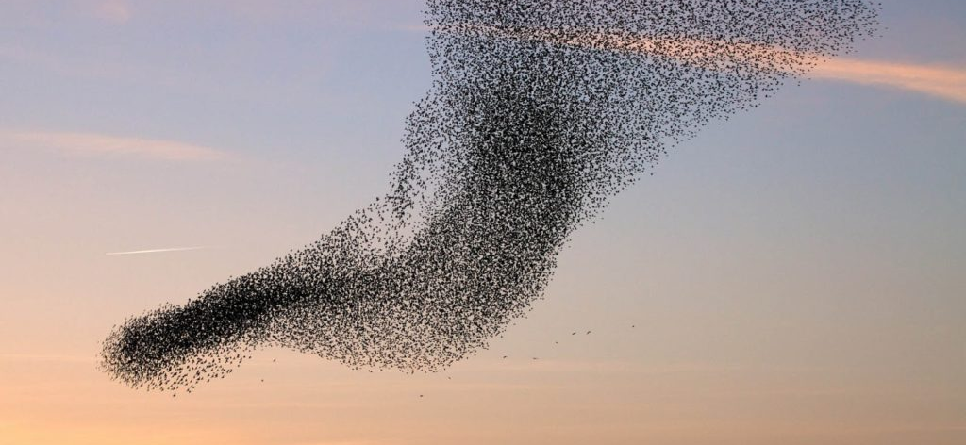
5-min snippet Flocking Model
Three rules:
Alignment
Separation
Cohesion
Notes:
Birds of a feather flock together
Do you think in these images, there is leading bird, or a bird that kinda leads the whole flock?
This model is an attempt to mimic the flocking of birds. (The resulting motion also resembles schools of fish.) The flocks that appear in this model are not created or led in any way by special leader birds. Rather, each bird is following exactly the same set of rules, from which flocks emerge.
The birds follow three rules: "alignment", "separation", and "cohesion".
"Alignment" means that a bird tends to turn so that it is moving in the same direction that nearby birds are moving.
"Separation" means that a bird will turn to avoid another bird which gets too close.
"Cohesion" means that a bird will move towards other nearby birds (unless another bird is too close).
When two birds are too close, the "separation" rule overrides the other two, which are deactivated until the minimum separation is achieved.
The three rules affect only the bird's heading. Each bird always moves forward at the same constant speed.
The fluid, lifelike behavior of the birds is produced entirely by deterministic rules.
Also, notice that each flock is dynamic. A flock, once together, is not guaranteed to keep all of its members. Why do you think this is?
After running the model for a while, all of the birds have approximately the same heading. Why?
Sometimes a bird breaks away from its flock. How does this happen? You may need to slow down the model or run it step by step in order to observe this phenomenon.

